Slide 1




Basketball II
Produced by Dr. Mario
UNC STOR 390

Slide 2
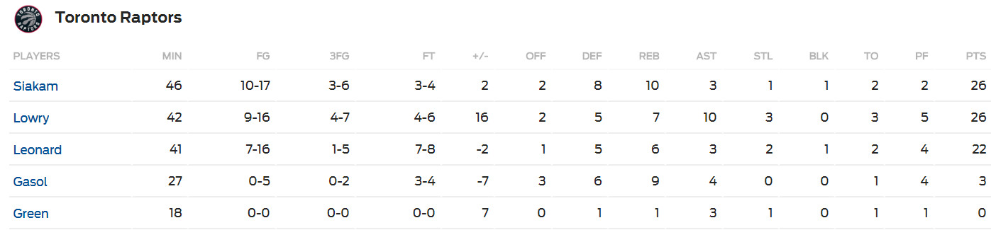
+/- Player Ratings
Recall the Box Score
Traditional Statistics Do Not Measure Player’s Ability to … “Make the Team Better”
Notice the Additional Metric

Slide 3
+/- Player Ratings
Pure +/- Ratings
Historically from Hockey
Number of Goals a Player’s Team Outscores Opponent When a Specific Player is Playing on Ice
Highest: Bobby Orr, 1970-1971, +124
“Worst Statistic in Hockey” by Hockey-Graphs.com
Counting Statistic of Rare Event (Subject to Outliers)
Time on Ice Not Reflected
Players Who Play the Most and Least Have +/- Closer to 0
Weakest Players Not Given Time to Accumulate Negative +/-
Same Values are Not Equal i.e. +5 Can Result from Many Scenarios
Application to Basketball
Pure +/- Statistic Based on Points and Scaled to 48 Minutes
Depends on Quality of Players When Player is on Court
Players on Bad Teams (Below .500 Record) Get Penalized

Slide 4
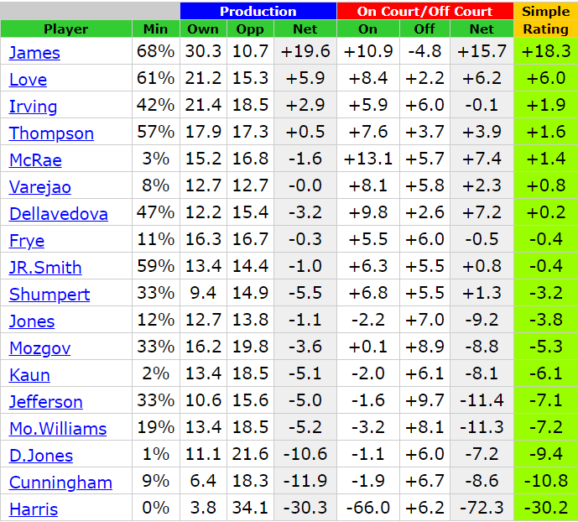
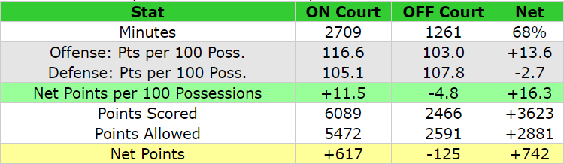


+/- Player Ratings
Pure +/- Ratings
Found on www.82games.com
Cavs Championship Season
Seasonal Player Stats
Lebron James on the Court
Lebron James on Bench
Pure +/- Per 48 Minutes
$$Net Points Per Min×48 Min=\frac{617}{2709}×48$$
$$=0.22776×48=10.9$$
$$Net Points Per Min×48 Min=\frac{−125}{1261}×48$$
$$=−0.09913×48=−4.8$$
$$Court −Bench=10.9−\left(−4.8\right)=15.7$$

Slide 5
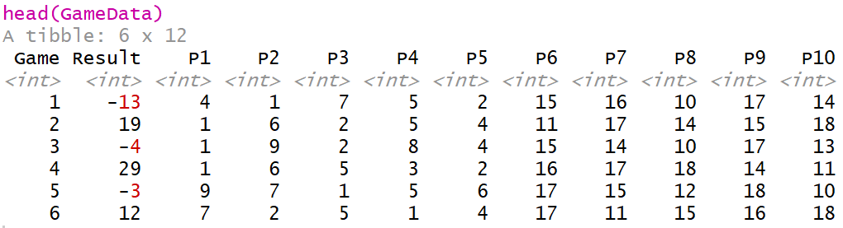
+/- Player Ratings
Adjusted +/- Rating
Adjustment for Teammates Played With
Adjustment for Opponents Played Against
Adjustments Based on Play-by-Play Data Over Whole Season
Average +/- Rating = 0
Simulated Game Data
Players 1-9 Compete Against Players 10-18 in 20 Games
Assume Starters Play the Entire Game
Results of Game Shown Below

Slide 6
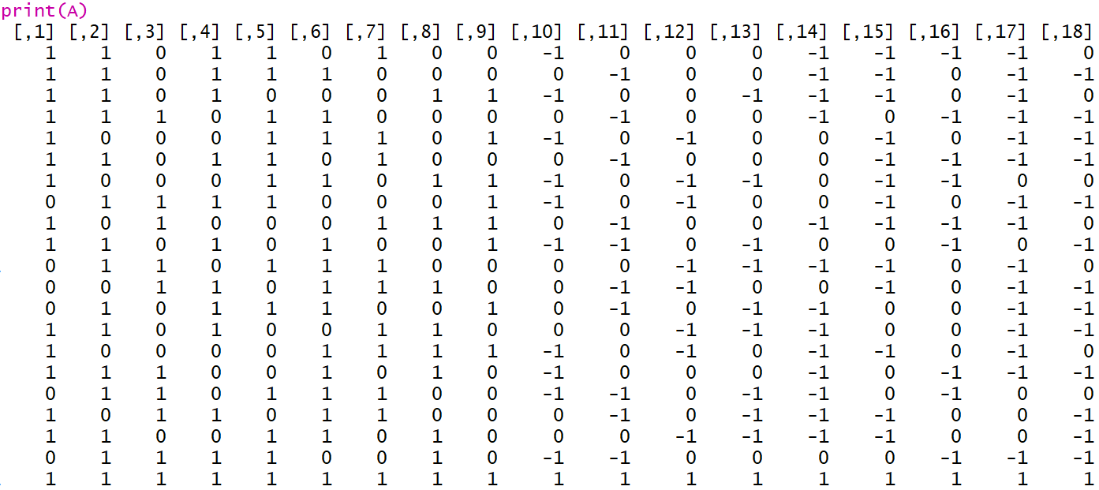
+/- Player Ratings
Modified Game Data into Matrix (A)
Each Row is a Different Game (Except Last Row)
Each Column is A Different Player
1 = Played on Team 1
0 = Did Not Play
-1 = Played on Team 2
Notice Last Row of All 1’s

Slide 7
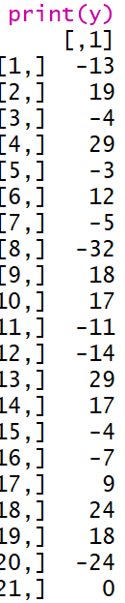
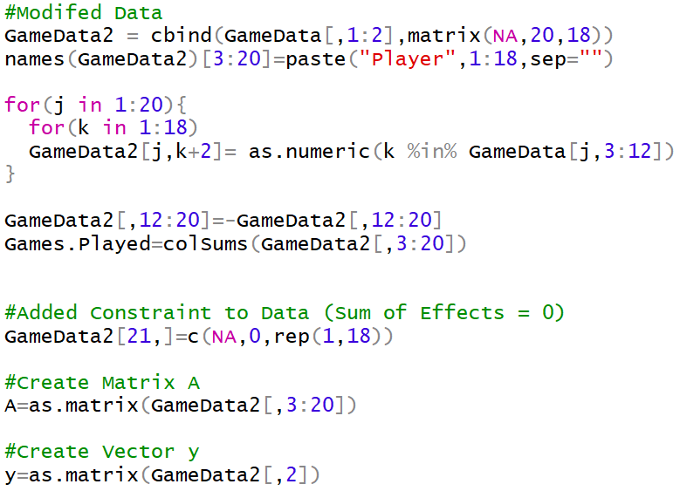
+/- Player Ratings
Game Results into Vector (y)
Each Element is a Different Game (Except Last One)
Notice 0 in Last Element
Code Used to Create Matrix A and Vector y

Slide 8
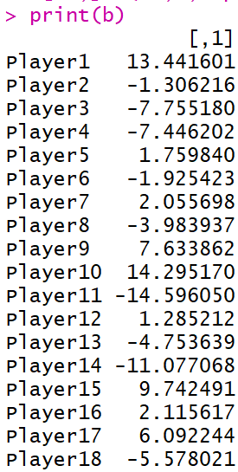




+/- Player Ratings
Goal: Estimate Adjusted +/- for All 18 Players
Expressed into Vector (b)
Constraint: We Want The Sum of Adjusted +/- to Equal 0
We Invoke Constraint With Last Row of A and Element of y
Solve the Linear Equation Using Least Squares Regression
Code for Solving System of Linear Equations
Adjusted +/- For Each Player
$$\overset{⃑}{b}=\left[b_{1},b_{2},⋯,b_{18}\right]′$$
$$\overset{⃑}{y}=A\overset{⃑}{b}+ε$$
$$\overset{⃑}{b}≈{\left(A^{′}A\right)}^{−1}A′\overset{⃑}{y}$$

Slide 9
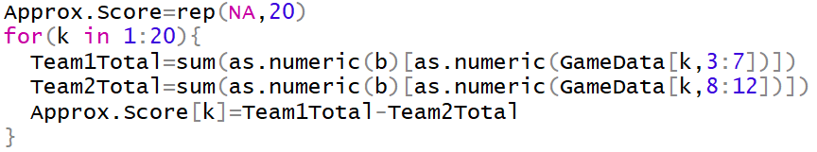

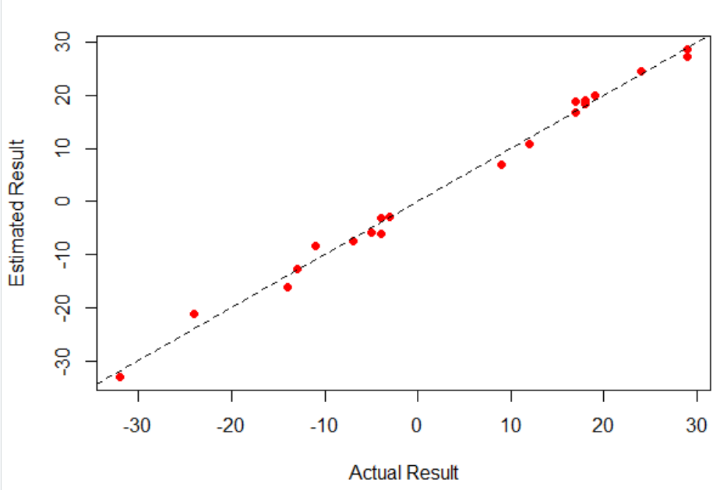
+/- Player Ratings
Can Be Used to Approximate Game Result
Code to Calculate Predicted Scores Using Adjusted +/-
Code and Graphic Comparing Predicted Versus Actual

Slide 10
+/- Player Ratings
Comparing Adjusted +/- to Pure +/-
Let’s Look at Player 15 Who Played 13/20 Games on Team 2
When in Game, Team 1 Averaged 5.4918 Points Above Average
When in Game, Team 2 Averaged 5.1072 Points Above Average
This Leads to a Pure +/- of -0.3846154 Points (Approximately Even)
When in Game and Ignoring Player 15, Team 2 Averaged 4.635 Points Below Average
Ignoring Player 15, the Pure +/- Would Be Horrible …
Adjusting for the Teammates Player 15 Was Playing With, We Would Adjust the +/- by Subtracting Pure +/- With Player 15 Minus Pure +/- Without Player 15 Would Be…
$$\left(−4.635\right)−5.4918=−10.12711$$
$$−0.3846154−\left(10.12711\right)=9.742491$$
Player 15’s Adjusted +/-

Slide 11
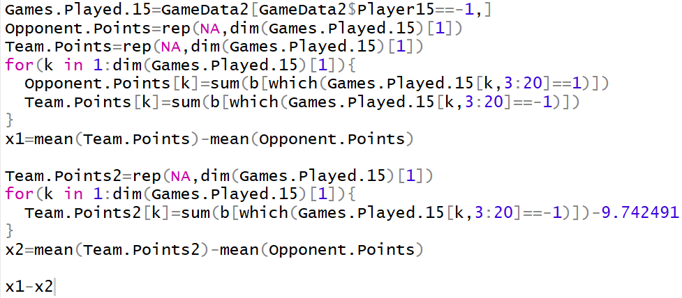
+/- Player Ratings
Comparing Adjusted +/- to Pure +/-
Code for These Calculations on Player 15

Slide 12


+/- Player Ratings
WINVAL System
Created by Wayne Winston and Jeff Sagarin
Adjusts for Home Team Advantage (+3.2 Points Per 48 Minutes)
Adjusts for Time Interval Where Court Composition is Constant
Home Team Scores 9, Away Team Scores 7, and 3 Minute Time Segment
Actual Adjusted Margin is 1.8 Points
Actual Adjusted Margin Per Minute is 1.8/3 = 0.6 Points
$$Adjusted Home Team Score=9−\left(\frac{3}{48}\right)×0.5\left(3.2\right)=8.9$$
$$Adjusted Away Team Score=7+\left(\frac{3}{48}\right)×0.5\left(3.2\right)=7.1$$

Slide 13
+/- Player Ratings
WINVAL System
Predicted Margin Per Minute
Goal: Choose Player Ratings So That the Predicted Margin is as Close as Possible to the Actual Adjusted Margin
$$Predicted =\left[\frac{3.2+Sum\left(Home Player Ratings\right)}{48}×\right]−\left[\frac{Sum(Away Player Ratings)}{48}\right]$$

Slide 14

Final Inspiration
Nine out of 10 schools are cheating.
The other one is in last place.
- Jerry Tarkanian

